Slide 2
UKRAINE RESEARCH DIVISION of JewishGen

Slide 3
Many Many Questions
What is the Ukraine Research Division
What do we do
How does it work
Who is involved
How can I be involved
What can I do to help
What can the Ukraine Research Division do for me
How can I find out what’s going on
What are plans and hopes for future work

Slide 4
CONTACT INFO Towns Director: Chuck Weinstein Chuck1@outlook.com Data Acquisition Manager: Gary Pokrassa GPokrassa@jewishgen.org Regional Director & Communications, : Stefani Twyford STwyford@legacymultimedia.com Research Director: Phyllis Berenson PBerenson@jewishgen.org

Slide 5
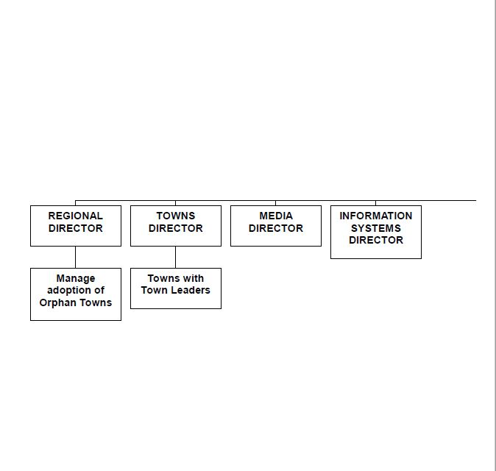
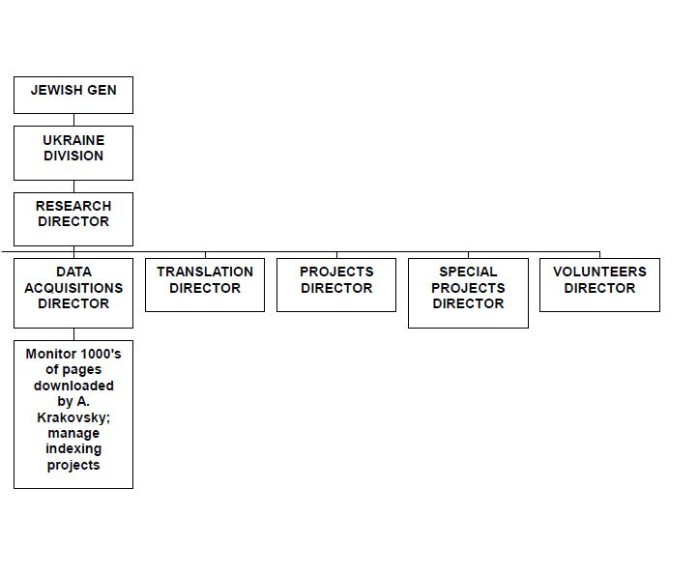
JewishGen Ukraine Division Organization

Slide 7
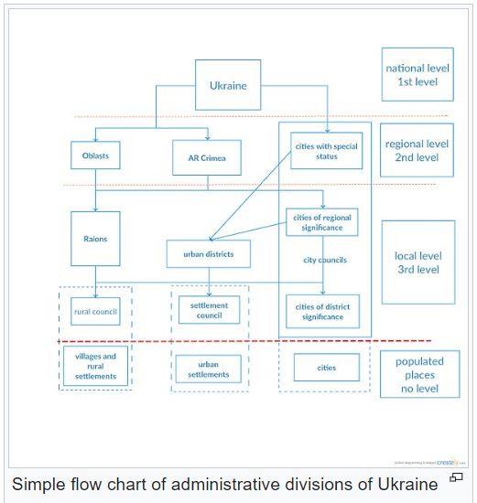

Slide 8
Towns in Ukraine

Slide 9
Vinnitsa Archive

Slide 10
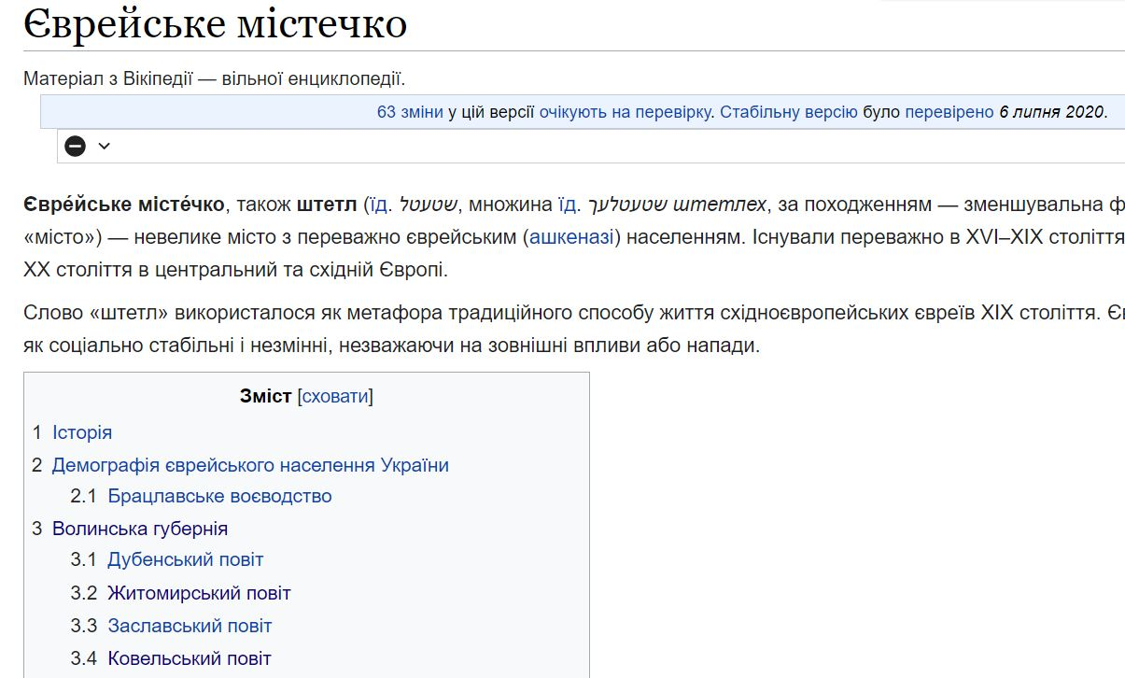
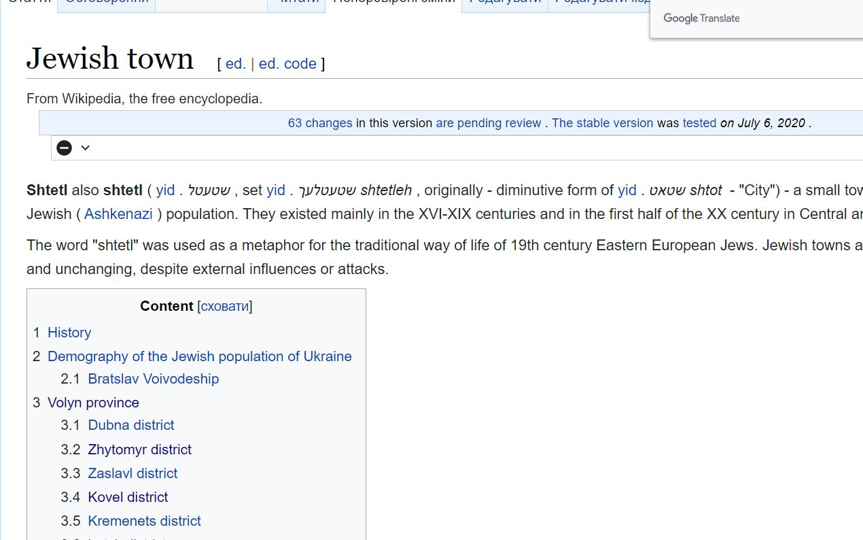
Alex Krakovsky’s
Wiki Site
Use Google
Translate

Slide 11
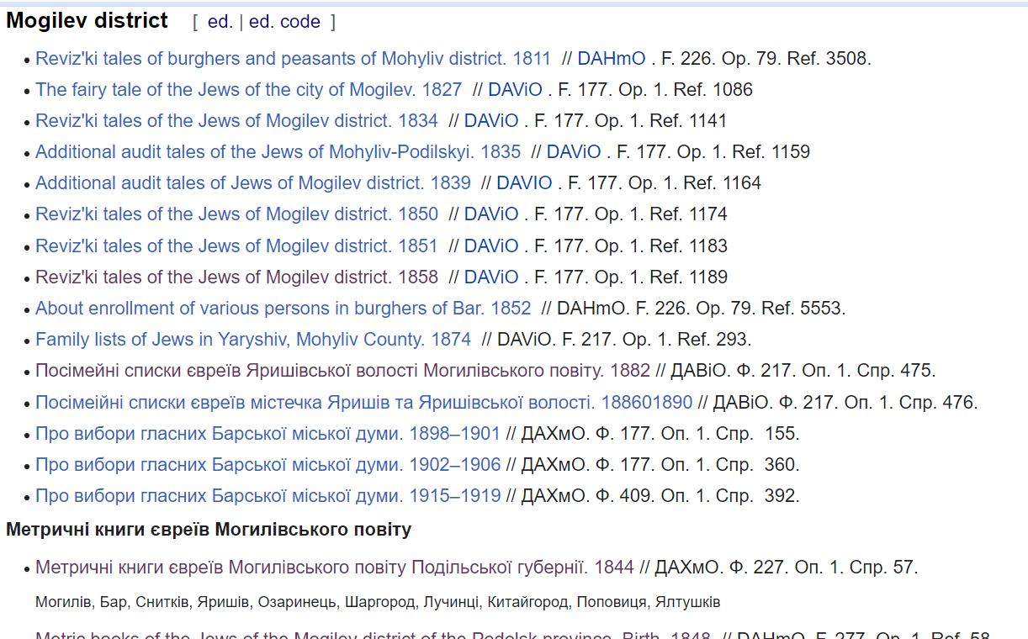

Slide 12
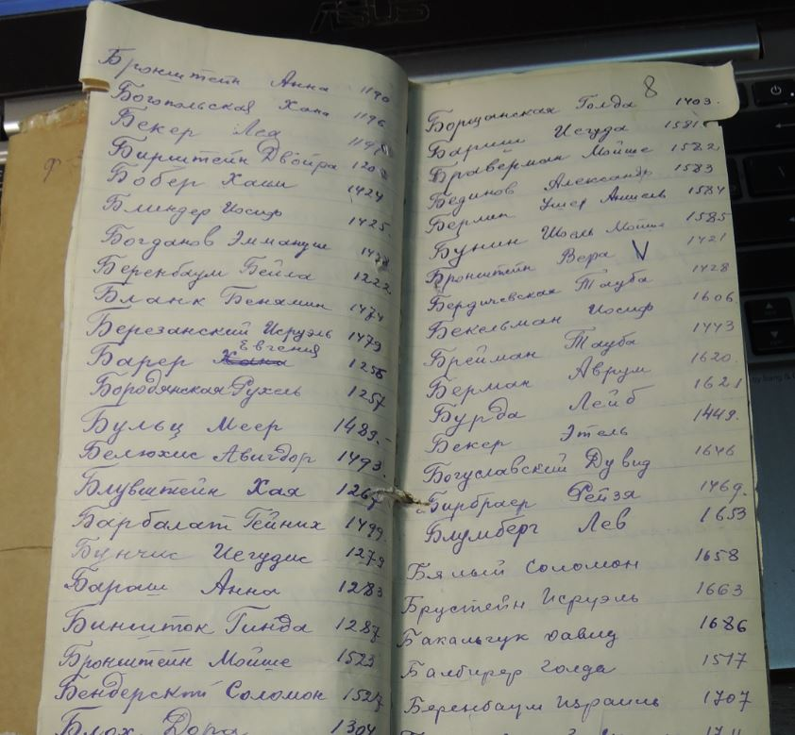
Alpha Index to Odessa
Metrical
Records
19th & 20th
Centuries

Slide 13
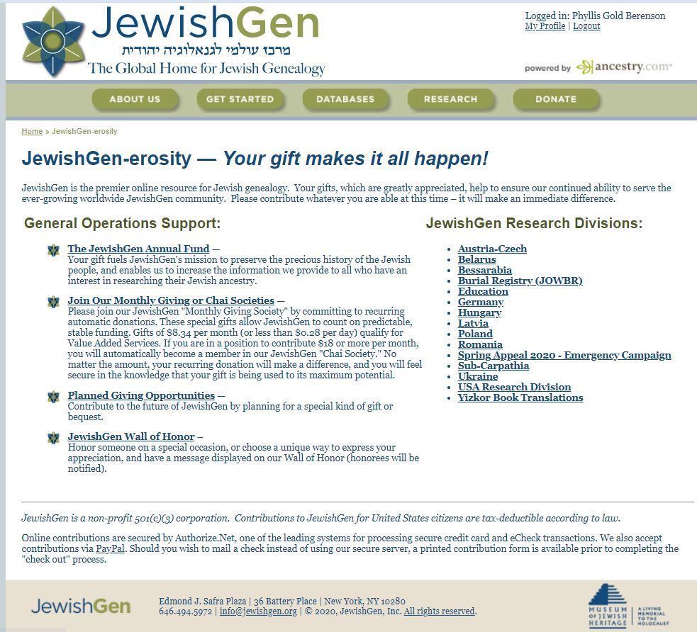

Slide 14
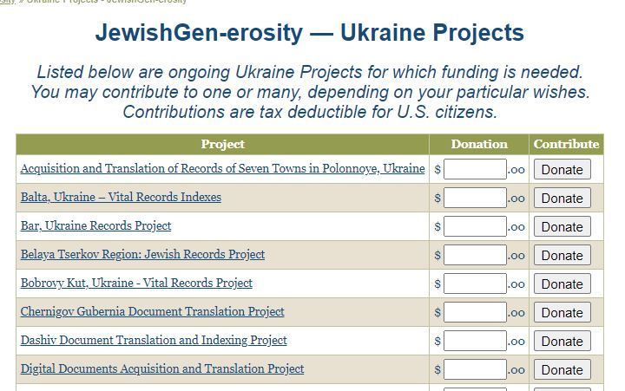
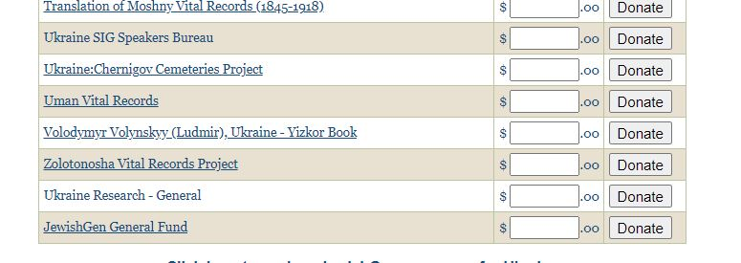

Slide 15
Berenson Children Mogilev-Podolskiy c. 1906

Slide 16
CONTACT INFO Towns Director: Chuck Weinstein Chuck1@outlook.com Data Acquisition Manager: Gary Pokrassa GPokrassa@jewishgen.org Regional Director & Communications, : Stefani Twyford STwyford@legacymultimedia.com Research Director: Phyllis Berenson PBerenson@jewishgen.org

